Slide 1

Investor Pitch Deck
Budget Update and Market Entry Plan — EU Launch 2025

Slide 2

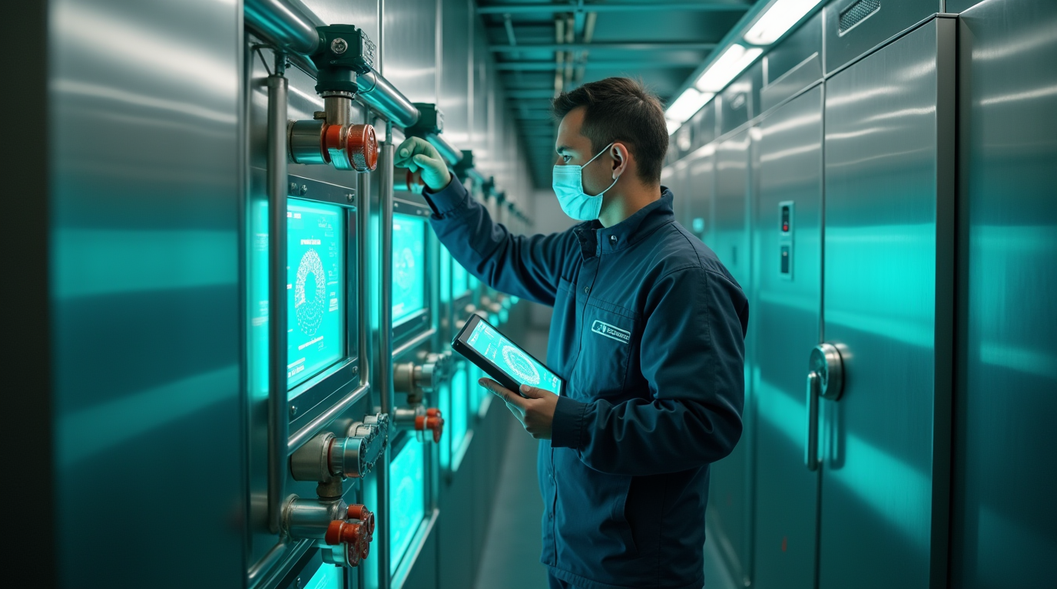
Summary of Required Work
Technical: System testing, AI programming, SaaS interface, installations, maintenance
Marketing: Market analysis, strategy, PR, events, certification, outreach

Slide 3

Initial Costs (Tripled)
System Testing: €24,000
Patent & Certification: €36,000
Registration & Relocation: €60,000
Production (100 units): €132,000
Supplies & Travel: €37,950
Internal Procurement: €30,600
Total: €320,550

Slide 4
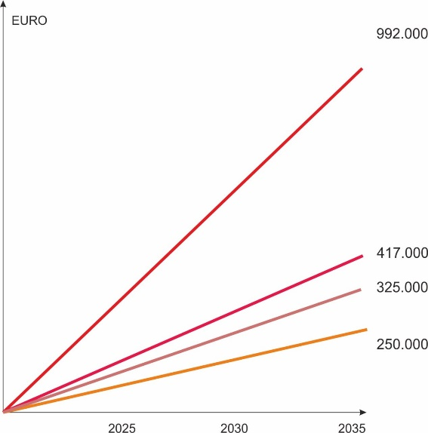
Graph of cost reduction for maintenance of low – temperatures freon complexes in Ukraine
1- Losses from freon’s leaks,
2- Losses from losses of condition of frozen products,
3- Losses from losses of technical service and repair minus SMBFL cost.
4- Total losses.

Slide 5
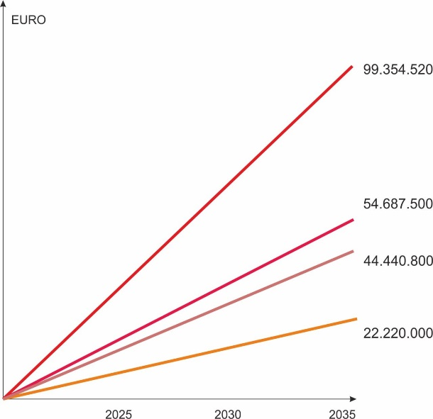
Graph of cost reduction for maintenance of low – temperatures freon complexes in Euro union without taking into account the transition from freons to carbon dioxide and propane.
Taking into account the cost of freons in the European Union of approximately 50 euros per 1 kg and the number of supermarkets up to 14,000, the losses may be as follows, without taking into account the transition from freons to carbon dioxide and propane.
1- Losses from freon’s leaks,
2- Losses from losses of condition of frozen products,
3- Losses from losses of technical service and repair minus SMBFL cost.
4- Total losses.

Slide 6
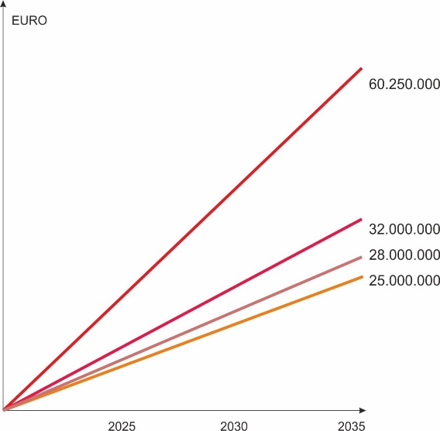
Graph of cost reduction for maintenance of low – temperatures freon complexes in Euro union with taking into account the transition from freons to carbon dioxide and propane.
1- Losses from freon’s leaks,
2- Losses from losses of condition of frozen products,
3- Losses from losses of technical service and repair minus SMBFL cost.
4- Total losses.

Slide 7
Conclusion
1. Centralized freon supply 10,000 supermarkets, 40 % and every 3 loss freon leaks.
independent freon supply 10,000 supermarkets, 60 % and a low-temperature volume loses 20 kg of freon every 3 loss freon leaks.
In total, 10 000 European supermarkets losses are 100 freon’s tons annually.
By 2035, this will be 1,000 tons, taking into account the introduction of new cooling systems on CO2 and propane, losses can be reduced to 700 tons.
Taking into account the aggressiveness of freons, the global warming index of CO2 can amount to
2,100,000 tons of CO2 emissions into the atmosphere.
2. The difference of the method is that it directly blocks freon leaks in automatic mode.
3. The method can be used at any low-temperature facilities, any warehouses.
4. The method must be certified in the automatic control system of refrigeration unit parameters as a direct continuous method for measuring freon leaks with an accuracy of 1 ppm.

Slide 8

Final Budget Summary
Base Budget (×3): €320,550
Market Analysis: €18,000
Market Entry Strategy: €15,000
UX/UI and SaaS: €12,000
Translations & Localization: €8,000
Digital Marketing: €20,000
Legal Support: €10,000
Partner Programs: €7,000
Total: €410,550

Slide 9
About us. Contacts
Email: vlastopulo0722@gmal.com
Phone: +380-996776823
Vladyslav Vlastopulo, SEO, Director of Harvard Marine, professor-consultant, Doctor of technical sciences in mechanical engineering, creator of the thermo-elastohydrodynamic theory of lubrication of heavily loaded plain bearings
or Yuzhagroholod L.C.C. or Harvard Marine L.C.C.

